Slide 1
INVEST DUDLEY

Slide 3
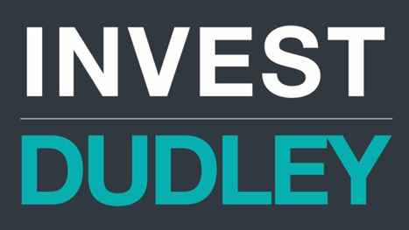
Helen Martin - Director Regeneration and Enterprise
Paul Mountford - Head of Planning and Regeneration

Slide 4
IT’S OUR TIME
Dudley Council and its partners have started to roll out a £1 billion regeneration programme, the biggest single investment ever made in the borough. This will make Dudley an even greater place to live, work and enjoy leisure time.

Slide 5
https://www.youtube.com/watch?v=NOwZHaOmudQ

Slide 6
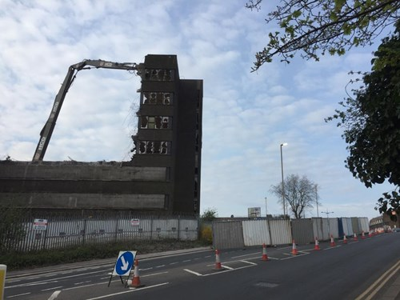
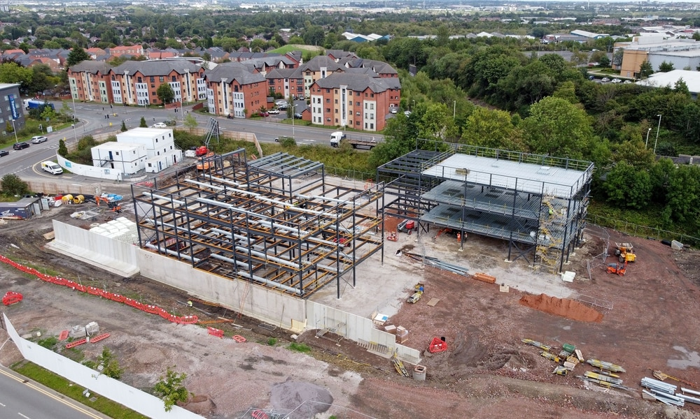
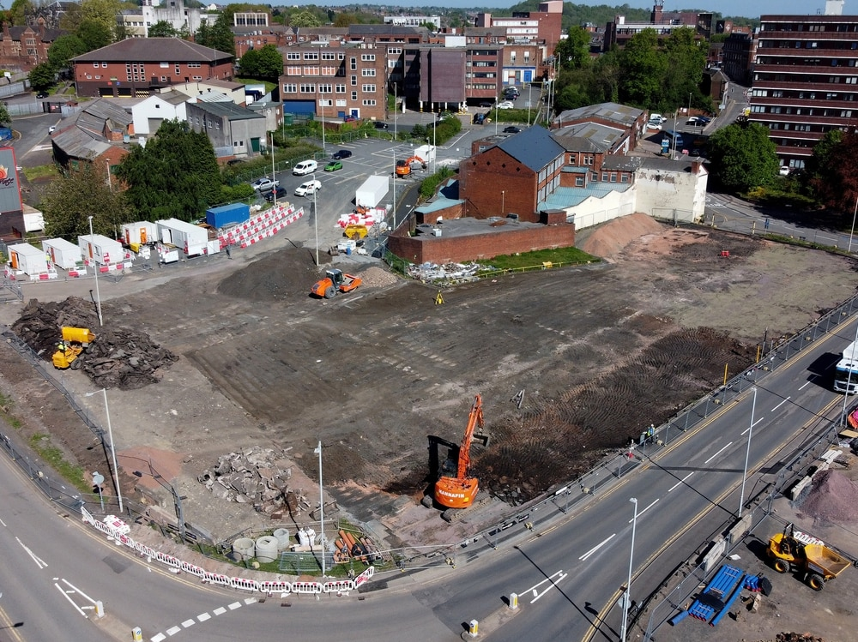
PROGRESS UPDATE
Cavendish House demolition
IOT construction
Leisure Centre construction
Notes:
While the world was in lockdown, a lot happened in Dudley.
A quick update since we last presented to you and your visit to the Town Centre
Demolition of Cavendish House, an eyesore that had been a blot on the Dudley skyline for almost two decades, finally took place in April, clearing way for the £82m Portersfield development.
Construction started on the new multi-million pound leisure centre in the Town Centre in May, with construction continuing while adhering to coronavirus guidelines.
The £4.33m retaining wall at Castle Hill that is the first physical structure as part of Dudley’s Metro connection plans is complete/nearly complete(??? Definitely looks like a lot has happened!) which will enable the next stage of the metro to be constructed and also pave way for work to start on the VLR.
The IOT is starting to take shape, giving a visible indicator to residents and businesses alike that change is coming to Castle Hill. Work was delayed for 6 weeks but construction crews are back on site.
Discussions and progress through the planning process has accelerated for some several town centre resi projects – both retail-resi conversions and new build developments. (Trident, Nuttals – not sure what can be mentioned in public)

Slide 7
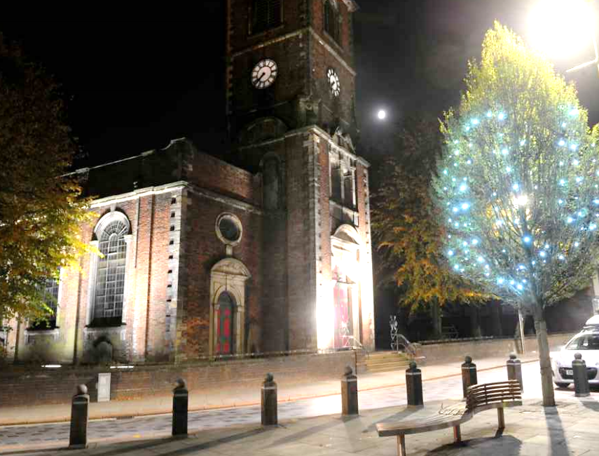
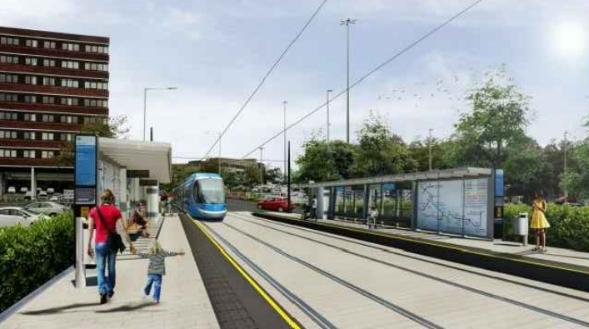
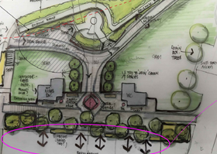
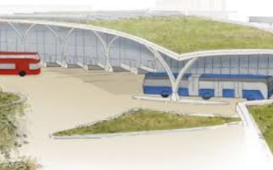
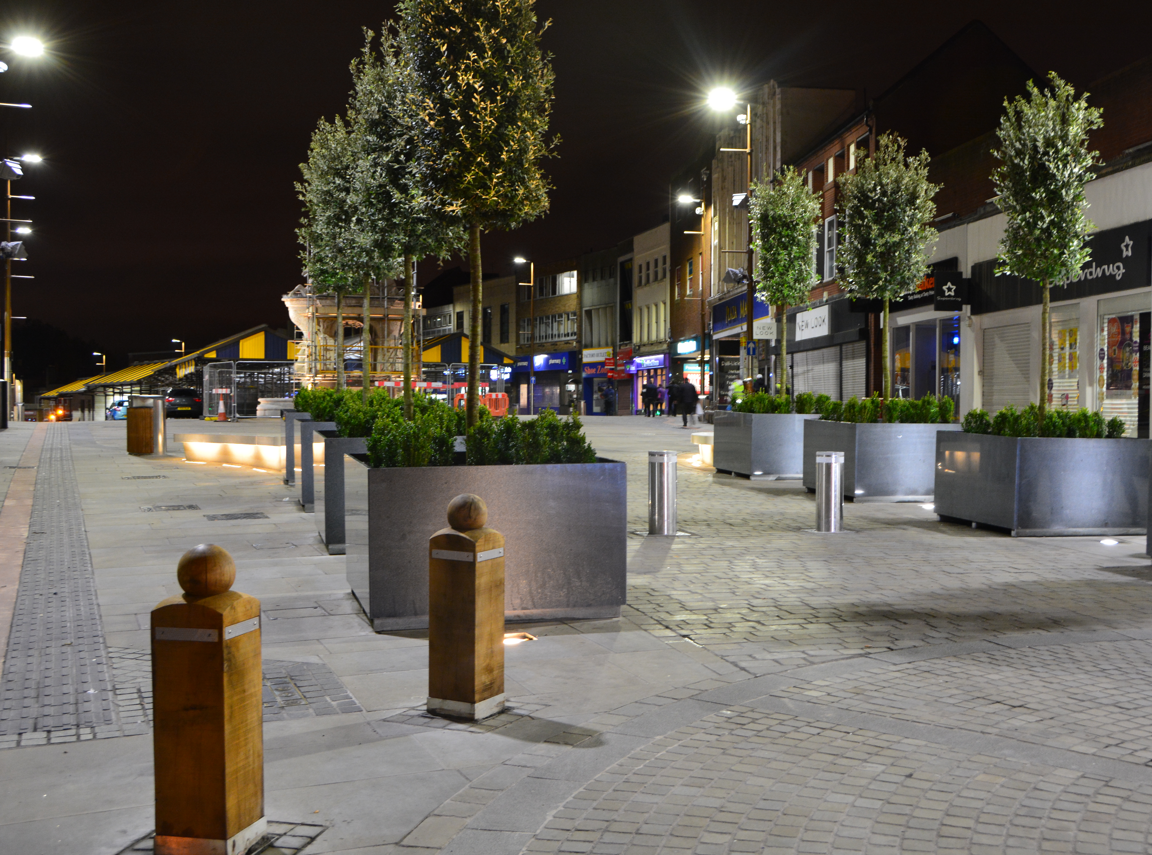
CONNECTED BOROUGH
Metro - Wednesbury to Brierley Hill Line
Commenced: 2019
Timeframe for delivery: operational by 2023
Value: £450 million
Public Realm
Package of public realm improvement works focussing on pedestrian connectivity.
Dudley Interchange
Project due for delivery in June 2022
Value: £20 million
Notes:
There is substantial investment committed to improve Dudley’s connectivity to the rest of the West Midlands and within the town itself, together with WMCA, the Council will deliver better connections with high-quality and affordable transport combining road, tram, rail and new cycling and walking infrastructure. This enhanced connectivity will enable commuter, educational, tourism and employment opportunities delivering a significant boost to the local economy. Some of the key projects include: New Wednesbury to Brierley Hill Metro Line, Dudley Interchange, Public Realm Works and Highway Improvement Package.
Metro – By far the biggest investment is the Metro, a total of £449 million will be invested by WMCA in the Wednesbury to Brierley Hill Metro which will extend the West Midlands Metro through the heart of Dudley town centre to Wednesbury and Brierley Hill and connect key regeneration scheme proposals with the wider sub-region. The 11km Metro line will deliver up to 10 stops including fast and frequent connections with Dudley Port Station, Dudley Interchange, the Waterfront and Merry Hill. It will connect Dudley with Birmingham in around 40 minutes, link Wolverhampton to Dudley in around 30 minutes and enable journeys between Birmingham and Brierley Hill in under an hour.
Interchange - Dudley Transport Interchange will be a world-class multi-modal facility tying together the new West Midlands Metro extension project and eventually the bus rapid transit (BRT) SPRINT. Dudley Council has granted outline planning permission to WMCA for the proposed development and this includes the demolition of the existing bus station. A total of £20 million in funding has been ear-marked by WMCA and the Black Country LEP for this project which is due for delivery in June 2022.
Public Realm- Metro an Interchange investments will be complemented further with substantial package of public realm and environmental improvement works focussing on improving the pedestrian connectivity between the Castle, the College campus and the town centre. Our ambition is to create an integrated the town centre, benefitting from improved connectivity and significant public realm improvements, providing opportunities for a green network that will be focused around the InHedge Public Space and Gardens. Question - A key challenge is how do we fund public realm which doesn’t’ naturally align to funding streams and during difficult economic time we may not/will not obtain the costs from the investor.
Place Making - Dudley Council are committed to sustainable place making by implementing the principles of sustainable development, involving good urban design which focus on social, economic, transport and environmental factors. The Council are supportive of the protection, and where possible the extension of, green corridors, footpaths and cycle ways, and are seeking to provide alternative transportation options aiding with climate mitigation.
Highway Works - Highway Improvement Package (Commenced: January 2020 - Timeframe for delivery: May 2022). This key investment will help facilitate highway improvements to accommodate the new Dudley Transport interchange while also creating the infrastructure and development platforms to support the delivery of the multi-million pounds Portersfield mixed-use redevelopment scheme. £600,000 of funding has been committed by WMCA to the demolition of Cavendish House which commenced in January 2020 as part of the Portersfield scheme with further funding being sought via Dudley Council’s bid to WMCA for funding towards Highway Improvement Works
This significant investment will set a new context for development and regeneration of our town centre and the wider borough. It will offer potential to intensify land uses, and recognising the linkages between them is increasingly important, enabling them to work successfully and sustainably in the future for the benefit of its local communities. Capturing this change for the benefit of the town, its residents and investors is a core ambition for the Council.

Slide 8
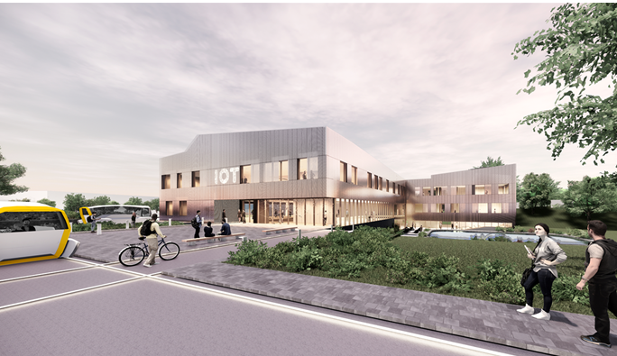
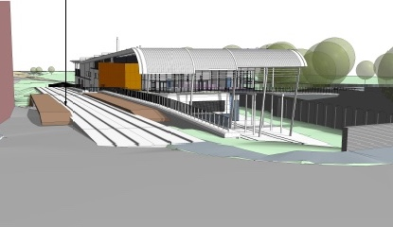
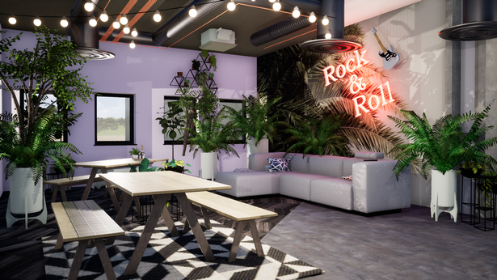
SKILLS FOR THE FUTURE: EDUCATION AND INNOVATION
Black Country and Marches
Institute of Technology
Very Light Rail
Innovation Centre
Resonance

Slide 9
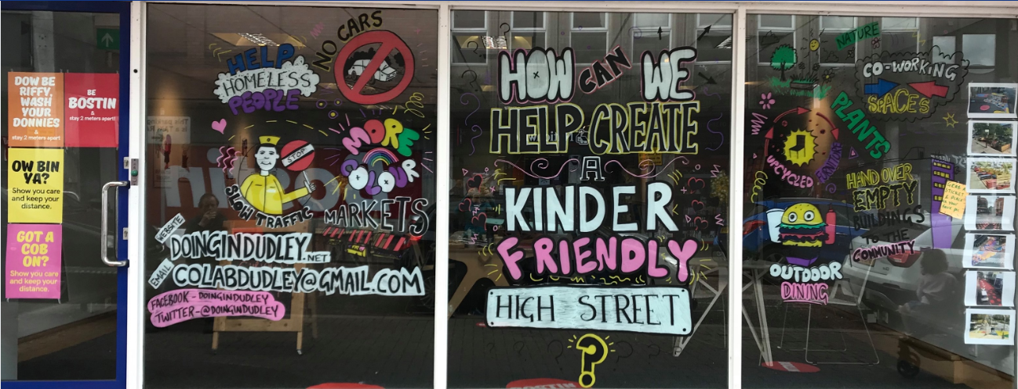
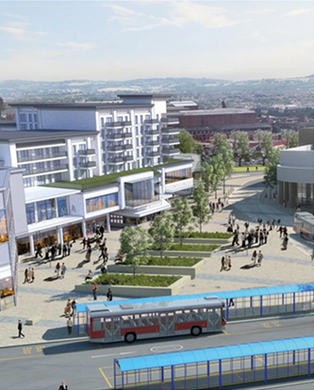
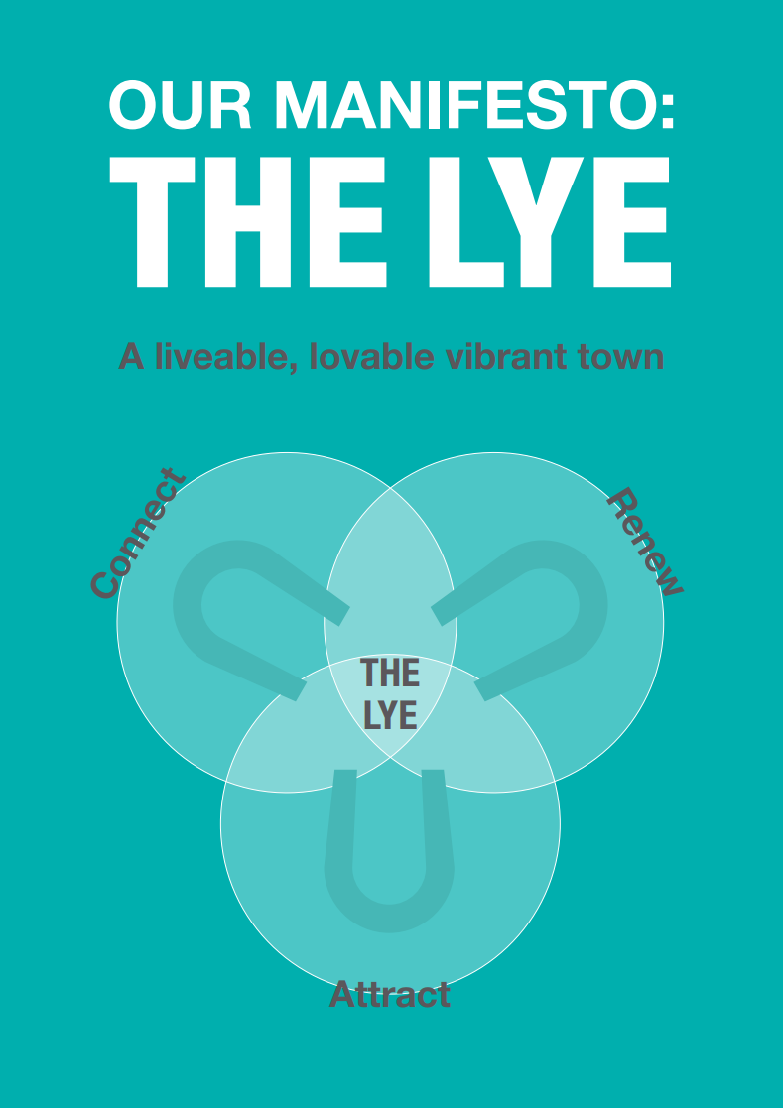
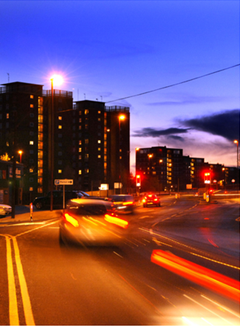
TOWN CENTRES

Slide 10
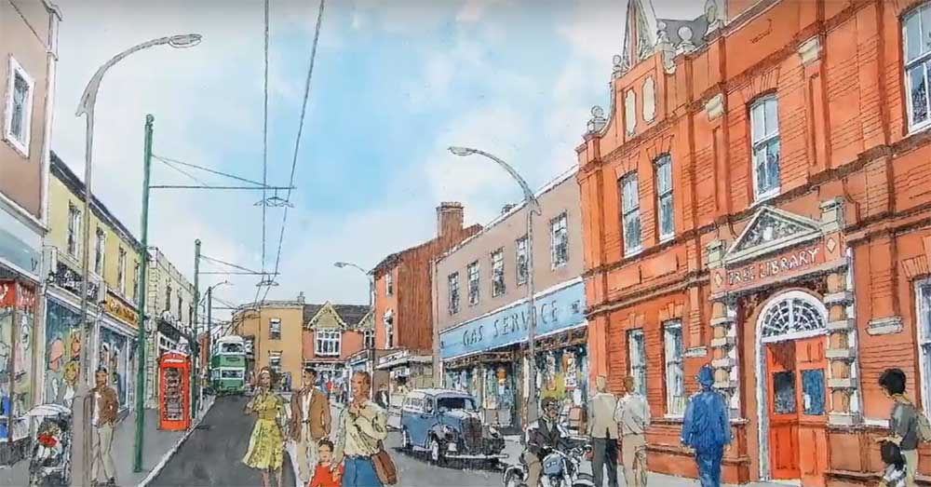
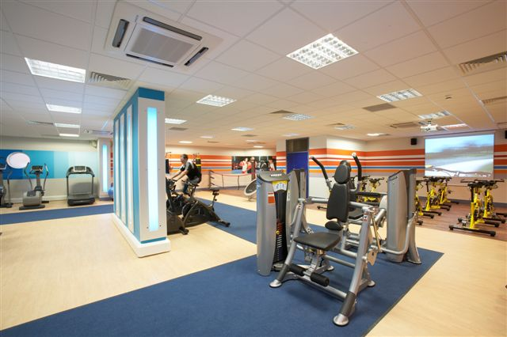
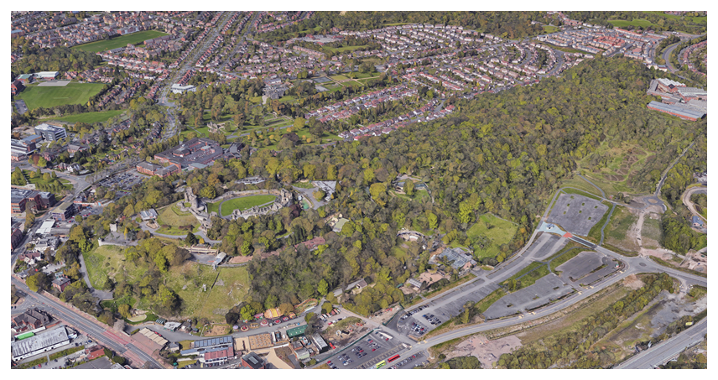
LIFESTYLE AND VISITOR ECONOMY
Black Country Living Museum
Commenced: 2020
Timeframe for delivery: 2022
Value: £24 million
Dudley Leisure Centre
Commenced: Summer 2020
Timeframe for delivery: Operational by 2021
Value: £18.2 million
Castle Hill Vision and Dudley Castle Zoological Gardens
Commenced: Project Proposals Progressing
Value: £13 Million

Slide 11
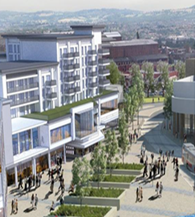
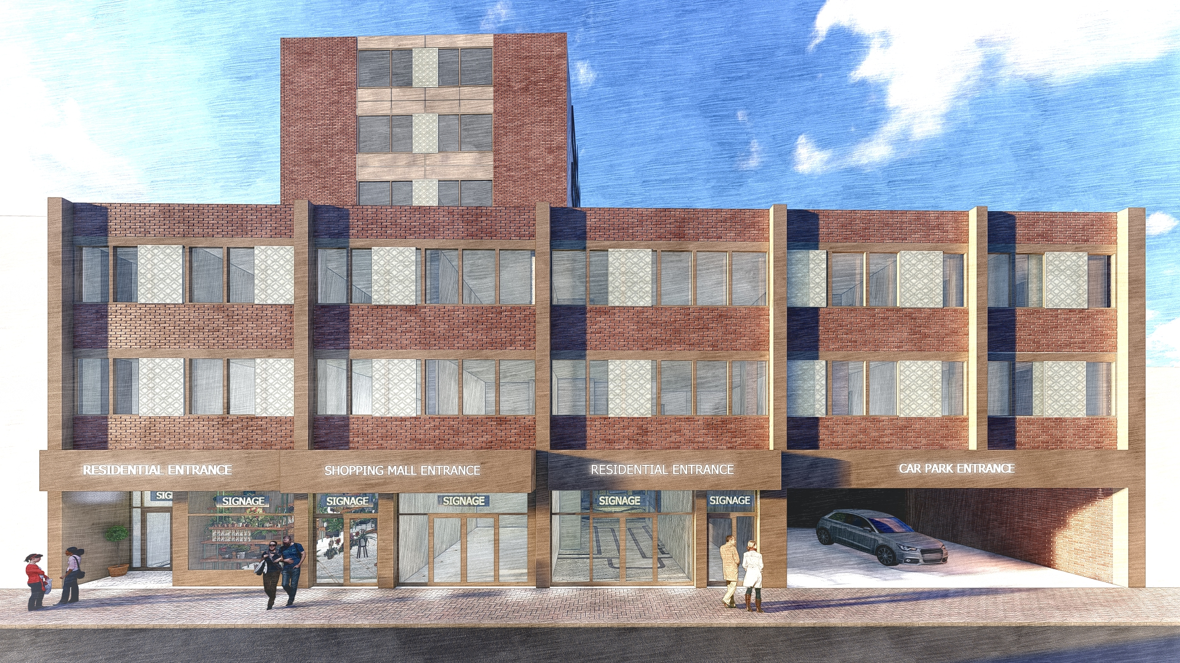
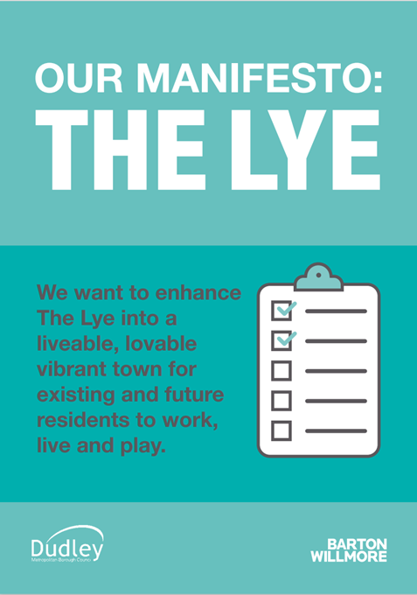
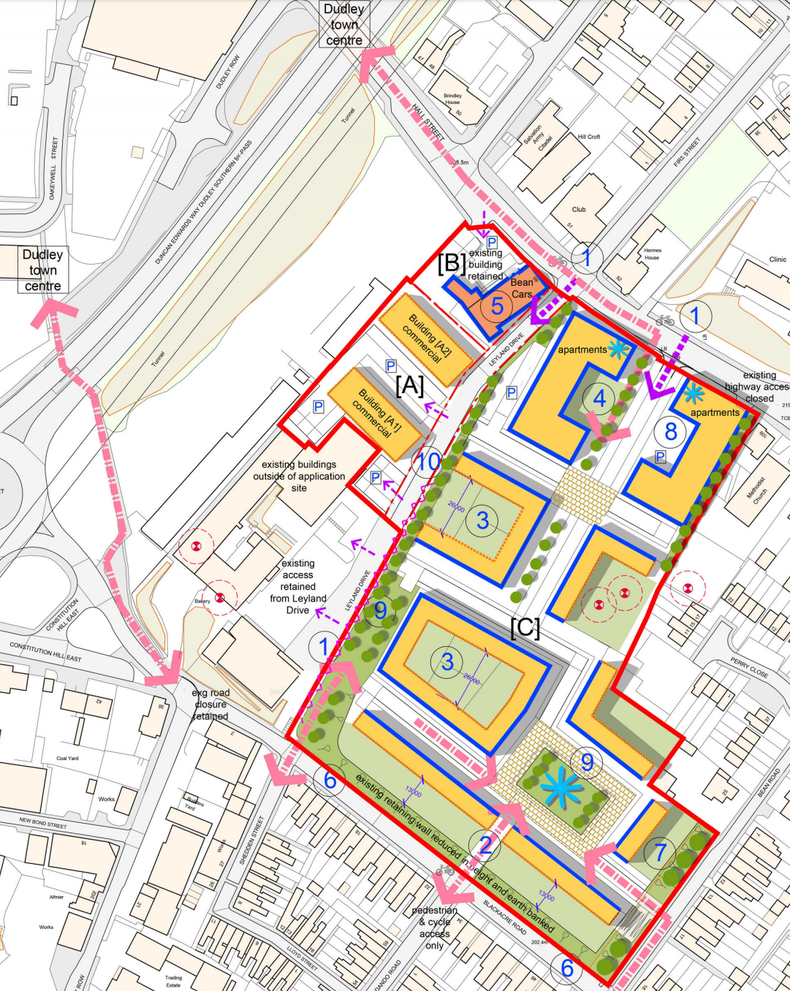
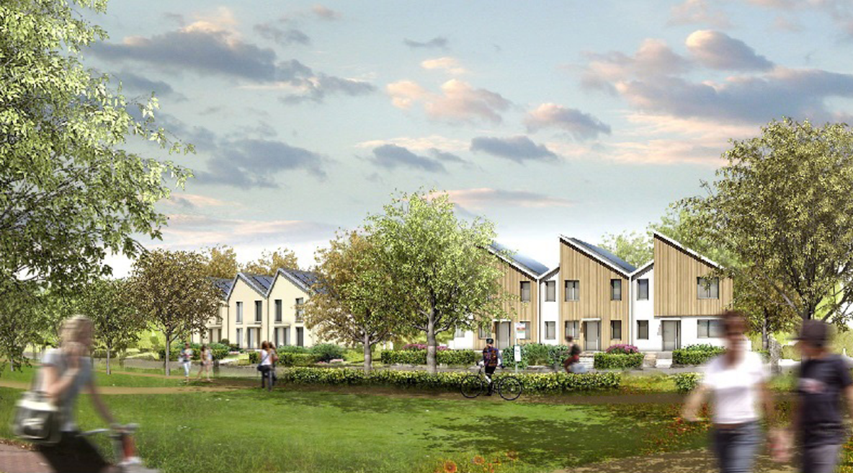
RESIDENTIAL OPPORTUNITIES

Slide 12
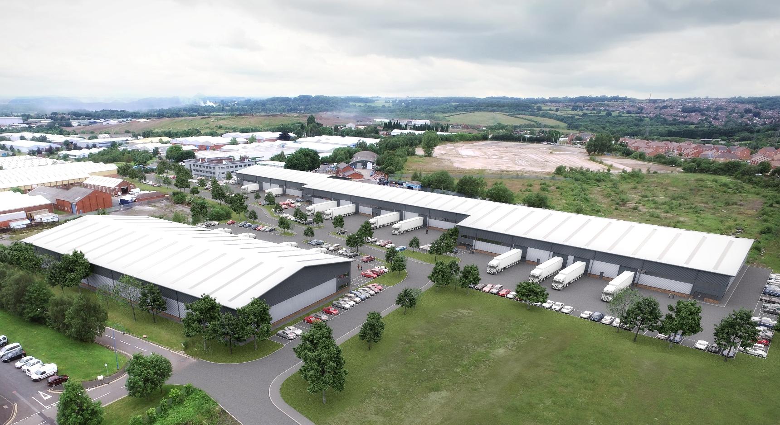
DY5 – INCREASED INDUSTRIAL & WAREHOUSE SUPPLY
LCP Prime Point - Pensnett

Slide 13
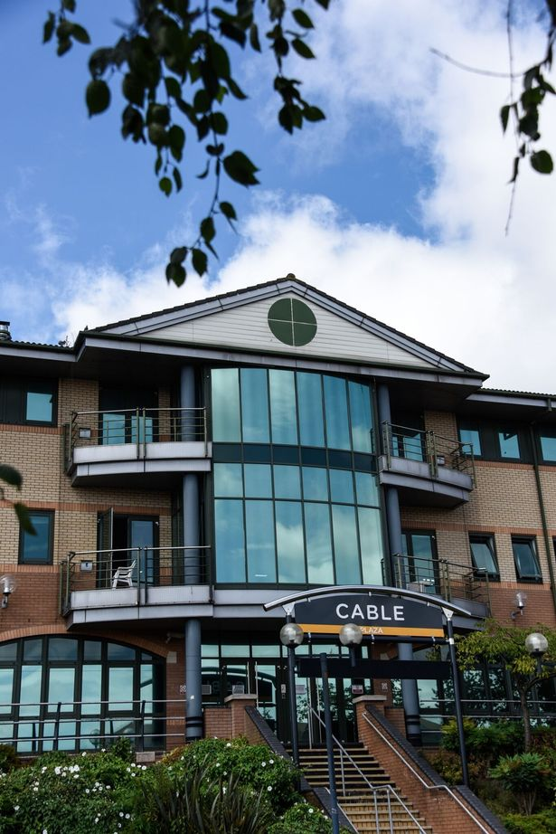
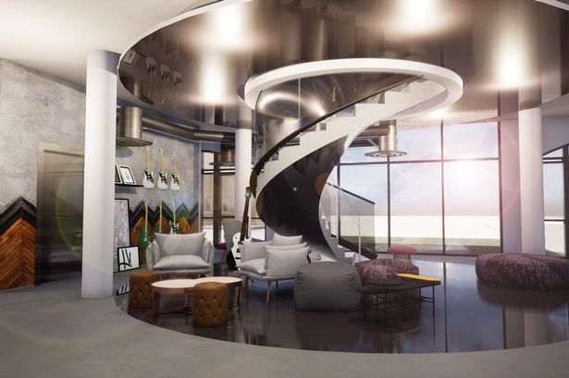
DY5 – THE WATERFRONT – BUILDING MOMENTUM
Resonance – The Waterfront

Slide 14
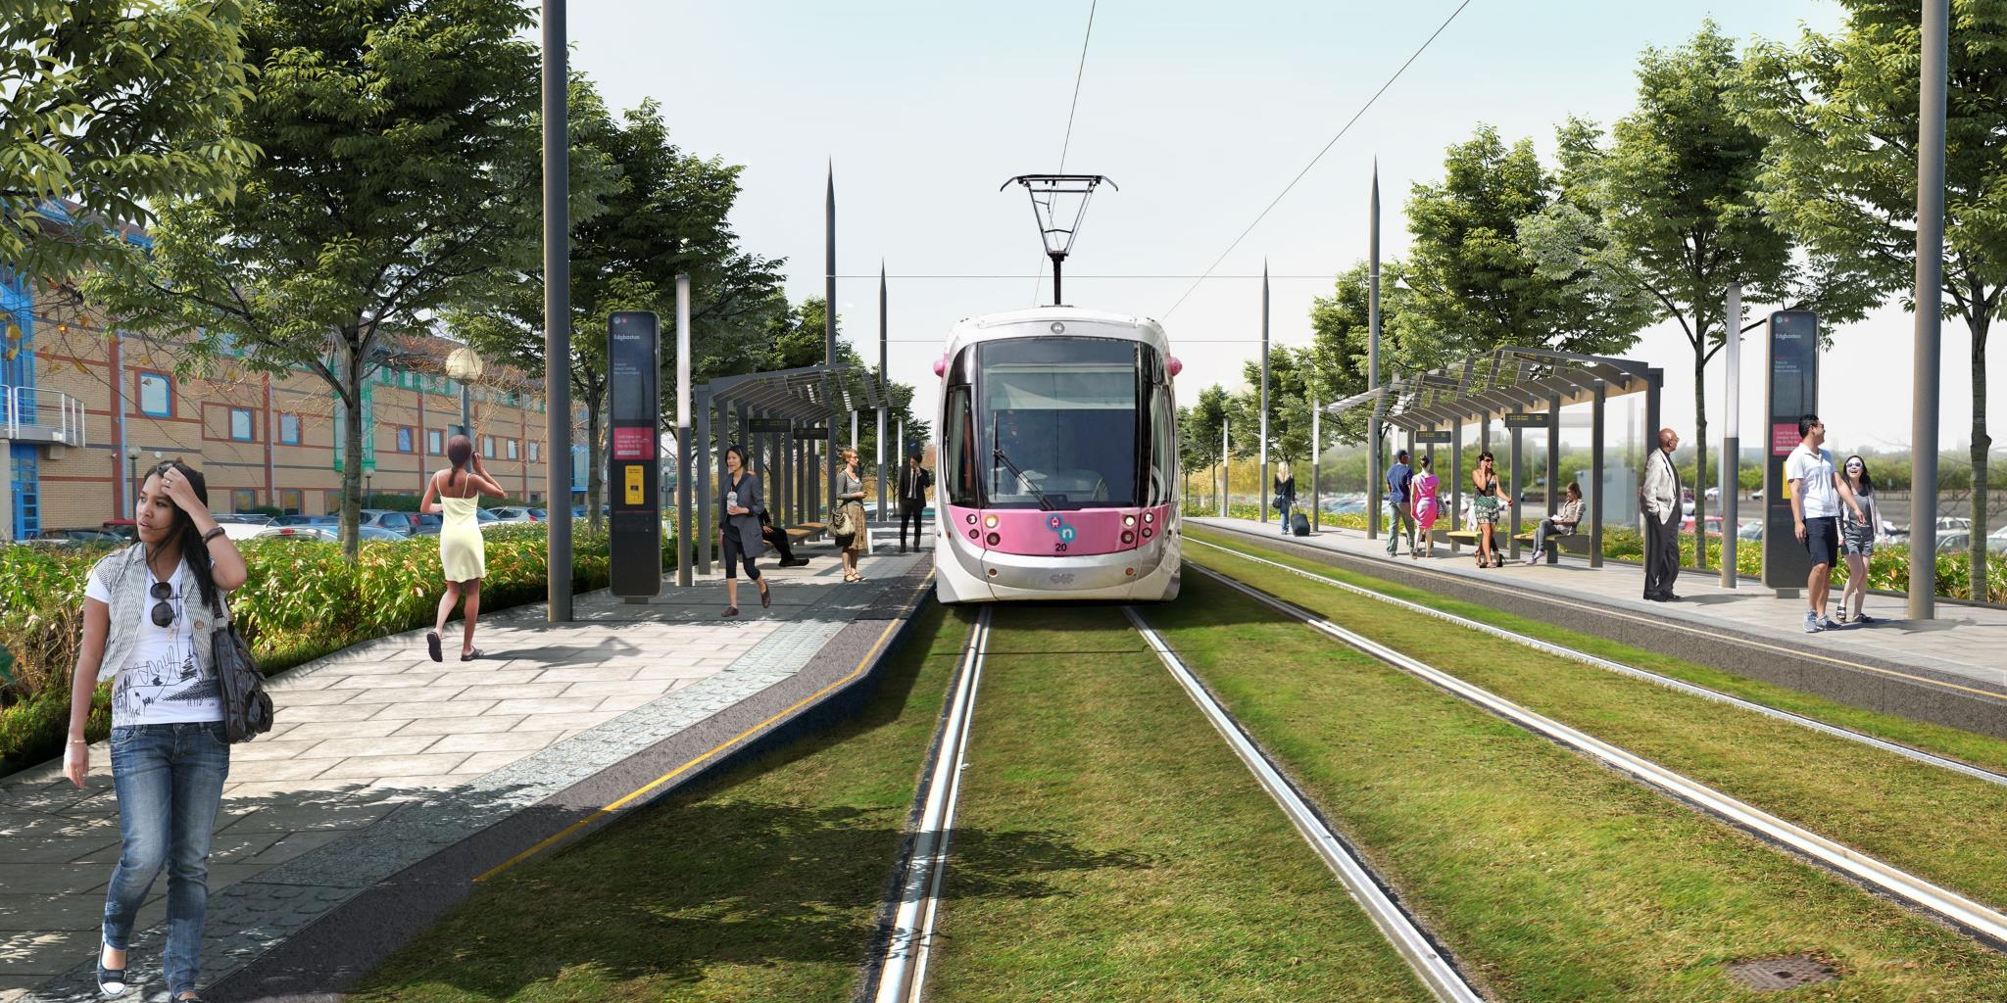
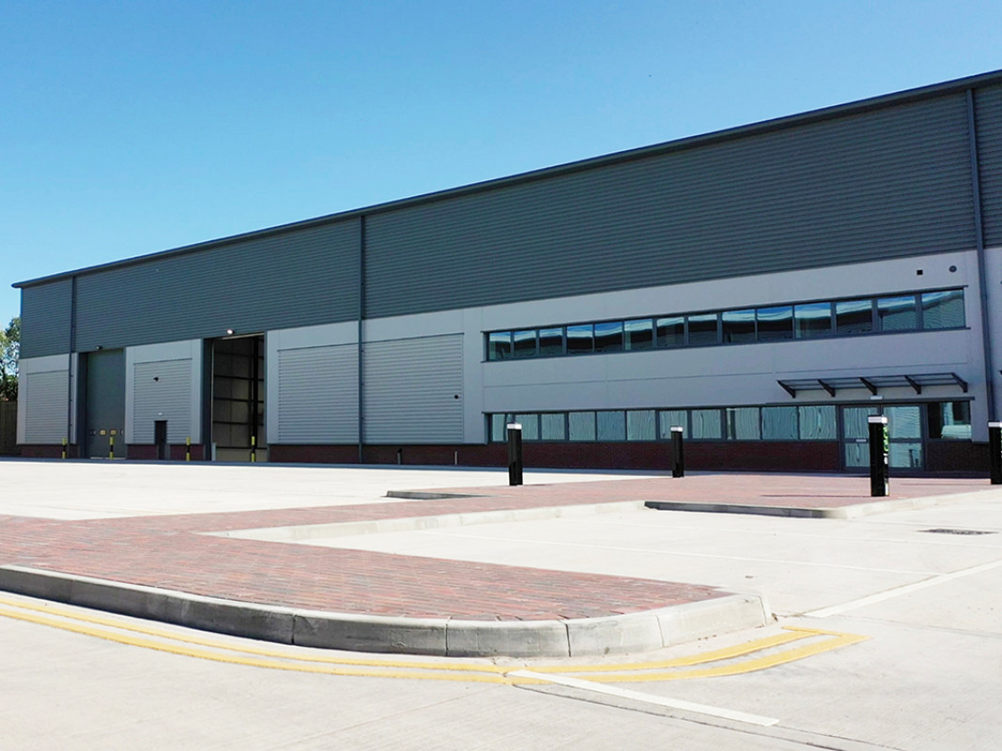
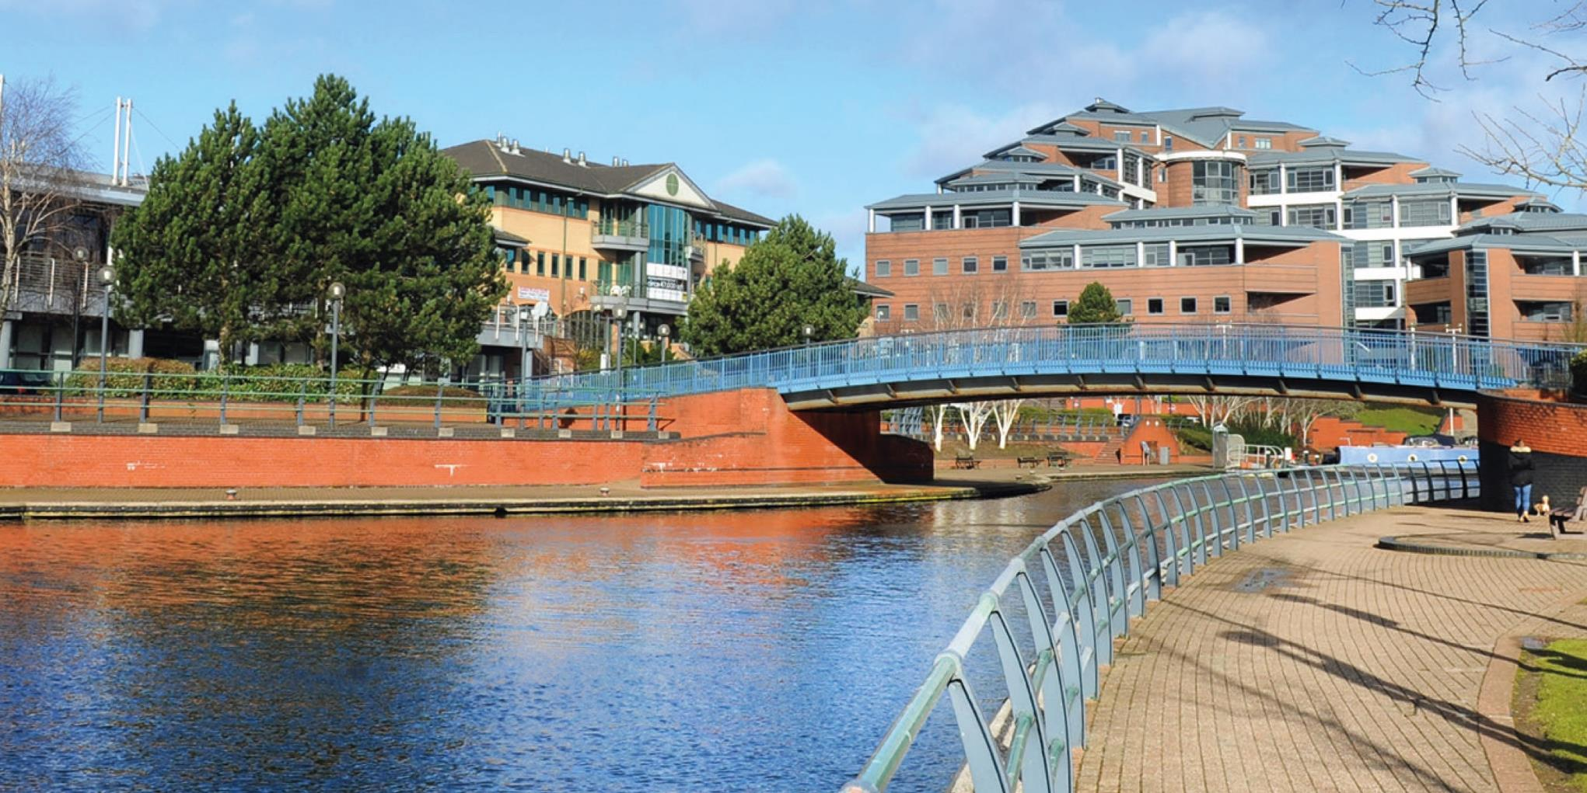
DY5 - NEXT STEPS

Slide 16
QUESTIONS

Slide 17
Thank You

